Slide 1
Maximizing Your Role as a Board Member:
The AAA Way
Latino Board Leadership Academy
May 1, 2024 LBLA XXVi Session 5
Kay Sprinkel Grace, Presenter

Slide 2
Agenda
Welcome, introductions and participant expectations
Becoming AAA board members: opportunity to advance your board’s priorities
Board AAA opportunities: Ambassador, Advocate, Asker
The full AAA program – a review
Reviewing the program: breakout rooms
AAA and fundraising: how they work together
Summary and conclusion

Slide 3

Discussion: Finding the Best Role as a Board Member
How to you imagine your involvement on a board?
What is your motivation for serving?
How can you get engaged in fund and donor development – the full AAA?
  Why AAA is a tool for board community engagement
  AAA: exploring one step at a time

Slide 4
Tapping Into Your Full Potential: Being An
Effective Member of a “AAA” Board Team
What AAA is
Why it works

Slide 5

Defining a
AAA Board
On AAA boards, every board member agrees to be an Ambassador – and may also be an Advocate and/or Asker
You are offered roles drawn from a strategic or development plan that are specific and geared to your interests and motivation
AAA crosses demographics, experience and interests, allowing you to work in your “confidence zone”
AAA is a powerful management tool

Slide 6
Roles Board Members Play in Creating Effective Fundraising Programs
Ambassadors
  Making friends
  Building relationships
Advocates
  Making the case (formal and informal)
  Key to solid board recruitment
Askers
  Making the ask
  “Front line” fund raisers

Slide 7

In Your AAA Roles
Rely on These Proven Principles
People give because you meet needs, not because you have needs
A gift to your organization is a gift through your organization into the community
All philanthropy is based in (shared) values and is increasingly about issues, not institutions (it is not about you…)
Fundraising is not about money - it is about relationships based on shared values
  These principles and the following diagram copyright Kay Sprinkel Grace

Slide 8
Philanthropy
Based in values
Development
Uncovers shared values
Fund Raising
Gives people opportunities
to act on their values

Slide 9




What Role(s) Will You Choose to Advance Your Board’s Fundraising?
Ambassador – Everyone
Advocate and/or Asker too?

Slide 10
1. Ambassadors
A role everyone has to play (no excuses!)
Key roles in cultivation of prospective donors and stewardship of continuing donor-investors
Need to have good board orientation and coaching in the messages about your priorities
Masters of the “elevator speech” (and the “elevator question”)
Catalysts for donor-investor renewal
Do you think you can you be a confident Ambassador? What will you need for success?

Slide 11
2. Advocates
At work or at the gym – you are strategic in your informal information sharing
You may also be asked to advocate for your organization on a more formal basis with government, another organization with which you are partnering or an institutional funder
Ask to be informed not only about the case for support, but also about your strategic plan and mission
Ask for coaching on desired results of the advocacy and handling objections
Does being an Advocate interest you?

Slide 12

3. Askers
Enjoy asking
Well informed, well trained
“Matched” with prospective or current donors for maximum possibility of success
Should be teamed with another board asker or staff leader
Staff should set up the ask so the Asker can focus confidently on getting (or renewing) the gift
Askers benefit from the work of the Ambassadors and Advocates
How many of you think you are or could be a confident Asker?

Slide 13
BOARD MEMBER
OPPORTUNITY CHECKLIST: Breakout Groups
In your breakout groups, please review the Opportunity Checklist you were sent and discuss which role(s) you might select to be involved as an Ambassador, Advocate and/or Asker.
You may select all that apply to you. In making your selection(s), assume that the organization on whose board you serve will provide training, materials and support to help you fulfill your role(s).
Discuss with each other and we will reconvene and review group-by-group afterwards.

Slide 14

Reports from Breakout Groups

Slide 15
Your AAA Role(s)
Some of you will do it all
Most of you will excel at one or two
Motivation is increased when you are working in roles that draw on your skills and are in your confidence zone
The AAA program can engage each of you in a role that contributes to the organization’s advancement and helps you feel both valued and engaged
As motivation increases, you will find yourself moving among the roles – perhaps even to Asker!

Slide 16
What You Need to Ask For:
Tools to Build
AAA Confidence
Continuing reconnection with mission, vision and values and revalidation of your board’s priorities
Staff and board leadership support, feedback and encouragement
A volunteer “tool kit” – including (but not limited to) fact sheet, elevator speech/question, stories from your organization, links to video clips, copies of e-newsletters, lists of objections/responses you may confront, financial statements, staff and board lists with annotation, organizational funding priorities, etc.

Slide 17
Measuring AAA Effectiveness
Number of contacts Ambassadors make – and report! Create an easy way to relay information to your prospect files (sample in the book).
Success of Advocacy: whatever the task assigned, was it accomplished? Did it have the desired results?
Success of the Asker is the easiest to measure
All three need to be honored: SOS

Slide 18
AAA Roles in Relationship Building and Fundraising
Through the lens of AAA
Cultivation
Solicitation
Stewardship

Slide 19
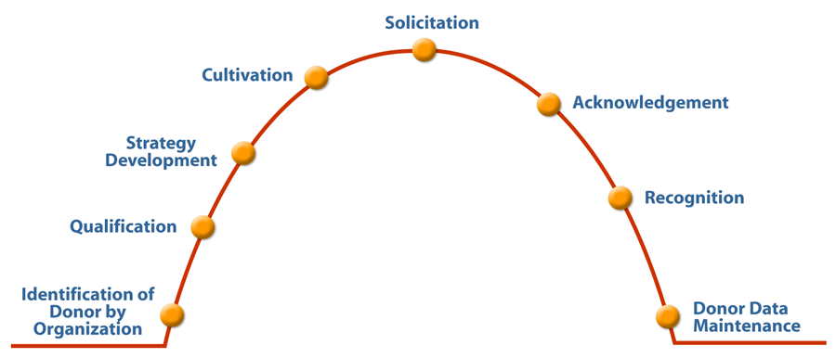
Transactional Bell Curve:
How We Have Asked for Money
High Impact Philanthropy
Kay Sprinkel Grace, Alan Wendroff

Slide 20
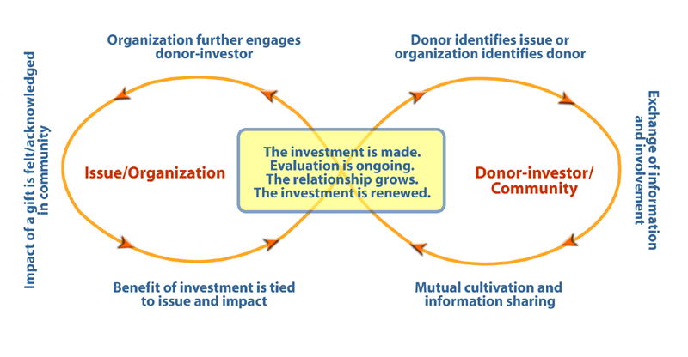
Transformational Infinity Loop:
How We Build Relationships
High Impact Philanthropy
Kay Sprinkel Grace, Alan Wendroff

Slide 21
What Donors Look For: TRUE
Trust
Can I trust what you will do with my gift?
Relevance
How relevant is your cause to me and my community?
Urgency
How urgent is the need you are meeting?
Experience
What will my donor experience be?

Slide 22
3 MOST IMPORTANT STEPS TO GROW YOUR DONOR BASE
CULTIVATION
SOLICITATION
STEWARDSHIP

Slide 23
Cultivation:
How we build relationships with potential donors
Ambassadors and Advocates are critical in the leadership and execution of effective cultivation
Cultivation is deliberate, systematic relationship-building and you are important in the process
Ask for a tool kit, systematic cultivation strategies and cultivation calendar
Use resources and intuition to move people from cultivation to solicitation to stewardship
Most important skill of good Ambassadors in cultivating donors: listening (2 ears:1 mouth)

Slide 24

Solicitation
If you are an Asker, asking is easier because everyone has helped to build the relationship (Ambassadors)
Some things to remember as an Asker:
  It is not about you: it is about the donor
  Teams of two are most effective (an Ambassador or Advocate may be happy to come along – or a staff member serving the program)
  Rehearse, using an asking process that will frame your time and message
  Learn how to anticipate and handle objections
  Close appropriately based on the outcome of the ask (yes, no, maybe)

Slide 25
Stewardship
The ongoing relationship with a donor after the gift has been made -- the key to lasting Relationships
All three “A’s” play a role
All staff play a role because fundraising supports program development and implementation: involve those who are directing or providing your programs
Stewardship consists of letters, emails, Thankathons, appropriate recognition, on-going information about impact through stories, etc.
More than recognition: it is a true relationship

Slide 26
Stewardship Cycle:
Keeping Donors Connected
Gift
Stewardship
Strategy
Recognition
On-going impact feedback
Deepening Engagement

Slide 27
What AAA Organizations Report
Non-board volunteers are more engaged and major gifts committees (e.g.) are using the model
Staff members are getting involved as Ambassadors and Advocates – and many are making great Askers on team calls
AAA has been integrated into job descriptions and recruitment matrices
Confidence about their roles in relationship building and fundraising has increased among board volunteers

Slide 28

Closing Thought
  We are in a time of opportunity for nonprofits. While problems persist, we must remember that philanthropy is about abundance, not scarcity.
  Philanthropic giving, when adjusted for inflation, has been reported as down since the pandemic, but the amount of money being given for community investment is still great. GoFundMe and other online ways to give are more popular with younger donors. The ways people give are harder to track.
  The needs in our society have been amplified – from social justice in all its forms, to education, to the arts, to domestic violence and beyond. We are responding.
  All segments of our nonprofit community must take to heart that this continues to be a time to renew, reboot, reinvent, reimagine, rethink and rebuild our communities.
  As board members, bring innovation to the table.
  When we innovate, it creates a pathway to a future that is more just, more equitable, more diverse, more abundant and more powerful.

Slide 29


“Things that are unraveling cannot be patched: we need to build the loom on which the next pattern can be woven.”
(Attributed to Sister Mary Clare, an Irish nun who served in the Crimea with Florence Nightingale).
This Photo by Unknown Author is licensed under CC BY

Slide 30
Maximizing Your Role as Board Members: The
AAA Way
May 1, 2024
Kay Sprinkel Grace, Presenter
www.kaygrace.org
kaysprinkelgrace@gmail.com
415/831-2923

